Slide 1


First Level Numeracy and Maths

Slide 2
Introductions
Miss MacPherson P2a
Mrs Hannon P2b
Miss Wilson P3a
Miss Allan P4a
Miss Johns P4b

Slide 3

Overview
What do we mean by Maths?
What do we mean by Numeracy?
How do we teach Numeracy at Broughton?
Workshops exploring the different strands of SEAL.
Notes:
Zoe

Slide 4
Topic Maths
Pattern
Shape
Time
Measure
Symmetry
Data Handling
Money
Fractions
Notes:
Kate

Slide 5

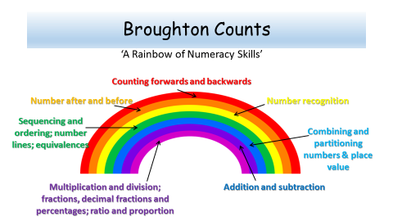


Notes:
Louise parent leaflet on website

Slide 6
Numeracy
SEAL - Stages of Early Arithmetical Learning
  Focus on understanding
  Structured progression to develop understanding
  Importance of the discussion of strategies.
The SEAL programme is broken down into 5 key strands.
  Number Word Sequences
  Numerals
  Number Structures
  Addition and Subtraction
  Multiplication and Division
Notes:
Clare

Slide 7
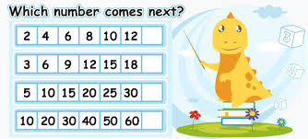
Number Word Sequences
Counting forwards and backwards:
In 1s and then multiples
Starting and stopping at different numbers
Crossing the decade
Finding the number before/after
Notes:
Kate

Slide 8
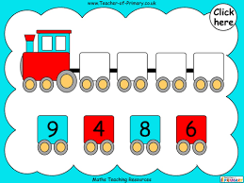
Numerals
Recognising numbers
Finding a number
Sequencing numbers
Ordering numbers
Notes:
Christie

Slide 9
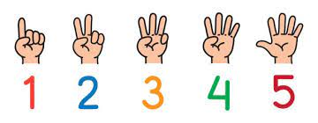
Number Structures
Dice patterns
Random/Pairs Patterns
Finger patterns
Doubles and near doubles
Number frames and number bonds
Notes:
Louise

Slide 10
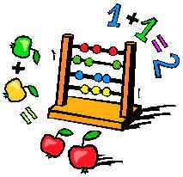
Addition and Subtraction
Counting objects
Adding by counting
Screened collections
Combining and partitioning numbers
Adding and subtracting from decades
Missing numbers in sums
Using learnt facts
Notes:
Zoe

Slide 11
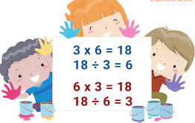
Multiplication and Division
Describing equal groups
Making equal groups
Describing equal shares
Organising equal shares
Describing arrays
Counting and combining equal groups
Applying in word problems
Notes:
Clare

Slide 12
Workshops
Spatial Patterns & Combining and Partitioning /Number Bonds. Place Value. – Room 3
Addition and Subtraction – Room 4
Counting and Ordering Numbers Multiplication & Division – Room 2
Notes:
Christie

