Slide 1
Curriculum Evening
Second Level Numeracy – Learning Support and What to do at home

Slide 2
In school support
Individual support 1:1, using ‘power of 1’ and ‘power of 2’ books.
SEAL groups – This programme is how numeracy is taught in school and is usually used from P1-P4. (More information on the next slides).
In class support – teachers will differentiate learning to ensure that your child is able to access the numeracy curriculum.
Use of digital learning – ipads. (more information in room 17 ).
Use of practical materials to support learning. (more information in room 18).

Slide 3
The Rationale of SEAL
SEAL stands for the Stages of Early Arithmetical Learning.
SEAL is about …
  A clear progression of learning in number.
  Developing understanding, not teaching processes.
SEAL is not about …
  Rotations
  Games
  Following a scheme
Notes:
Sophie
Theory that should underpin our teaching of number and number processes.
Get very hung up on resources – it’s not about these, it’s about understanding children’s progression and supporting them adequately in their learning.

Slide 4
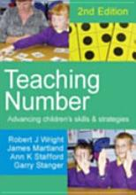
SEAL - Learning and Teaching – What?
(Five Key Strands in Teaching Number)
Number Word Sequences
Numerals
Number Structures
Addition and Subtraction
Multiplication and Division
Notes:
Counting – forward/backward number word sequences (in ones, then twos, tens etc.), number after/before
Numerals – recognition, identification, sequencing, ordering
Number Structures – Patterns (domino, random, finger, spatial, sound), partitioning (breaking up a number), combining (putting together numbers), doubles, building with 5 and 10
Addition and Subtraction – and related (e.g. missing addend)
Multiplication and Division – grouping and sharing, arrays
Each chapter focuses on the teaching of a different child e.g. emergent, and within each chapter there is teaching progression for each of these strands.
Focus for class teaching, after assessment of one child per group, is roughly a two week block on addition and subtraction – chance to try this and then discuss with colleagues.
Glossary to support teachers with new language

Slide 5
SEAL - Learning and Teaching – How?
Using the following maths recovery techniques:
    Visual representations
    Screens
    Wait time
    Micro-adjusting the task
    Asking about strategies used
    Self-checking
Notes:
SEAL based on maths recovery and uses same techniques
Visual representations needed for all learning, before moving to abstract (in upper years we move to abstract too quickly – or don’t do any visual at all).
Screening encourages children to count on (rather than counting all the items) – do not tell children to count on but “encourage” them (by listening to other people’s strategies or making first number bigger)
Micro-adjusting the task makes it simpler or harder – also good for differentiation for whole-class learning
Asking about strategies used – v common in class but again allows children to learn from others, teacher not telling children to use a certain strategy (and can name strategy “you used a count-on strategy”)
Self-checking allows children to see if they are right, or why they are wrong
Teaching Number book – has all teaching points

Slide 6
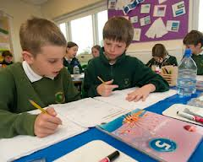
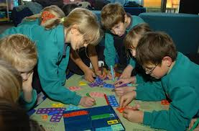
How SEAL is taught - Middle/Upper School/Secondary
Group work (in rotation)
Support group (with others working independently)
Focus on selected SEAL teaching points.
Mental Agility
Notes:
Can all be working on same topic (one group with teacher and other groups on activities related to topic)
Could teach topic to one group (and have others working on another maths topic e.g. shape)
Could teach through mental agility

Slide 7
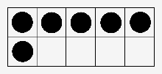
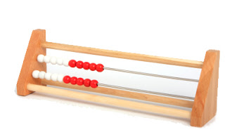
An example of some resources in schools – There are more displayed in the classroom.
Hands-on resources e.g. counting sticks
“Teaching Number” book (and disc)
Photocopiable resources (e.g. ten frames)

Slide 8
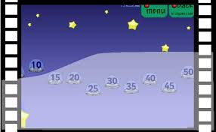
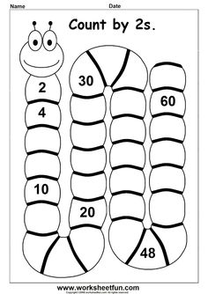
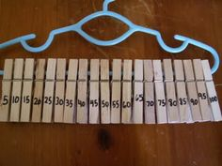
SEAL - Examples of Independent Activities
Dot cards to allow children to independently build and practise a multiple count e.g. counting in 5s
“Saucer Sorter” – ICT Games
Notes:
Dot cards, counting them with a partner
Lots of games online to play
Fun activity with clothes pegs they can attach starting with the biggest and then the smallest

Slide 9
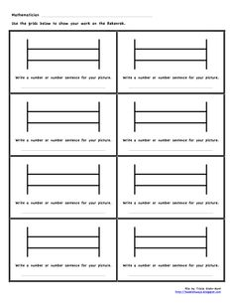
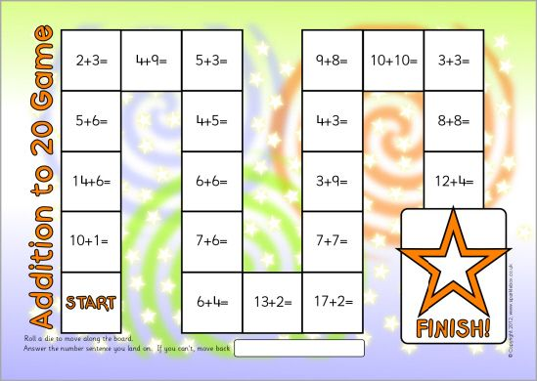
SEAL - Examples of Independent Activities – There are more displayed in the classroom.
This game is all about strategies at this stage so children need to use what they have learned and share their strategy (they are not allowed to move on if they have counted in ones)
Children can demonstrate 2 different ways to make numbers up to 20 e.g. 14 as 10+4 or 7+7

Slide 10
An Addition Problem and the many ways children can use to solve it.
This is why we help the children develop their understanding and not just teach processes.
Uses a split strategy e.g. 7 + 5 = 12 and then add 20
Needs to use counters or other concrete materials
27 + 5
= 32
Counts from one (1,2,3,....,27,28,29,30,31,32)
Uses a jump strategy e.g. 27 + 3 + 2
Counts on in ones from 27 (28,29,30,31,32)
Notes:
Discuss sophistication of strategies

Slide 11
Ideas for what you can do at home
Spot maths in the environment around you and talk about it. e.g. paying for items at the shops.
Practice telling the time.
Count forwards and backwards, stopping at starting at different points. (This can also be done with times tables).
Practice ‘missing addend’ style sums. 20 + __ = 46
Practice bridging to 20. 17 + 3 = 20, 18 + 2 = 20
Practice rounding numbers to the nearest 10 or 100 that you see in the environment.

