Slide 1
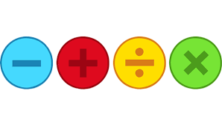
Whole number Teaching and learning

Slide 2
Adding
We have learned various strategies for adding:
Formal methods
Partitioning/Number lines
Adjusting
Finding missing addends

Slide 3
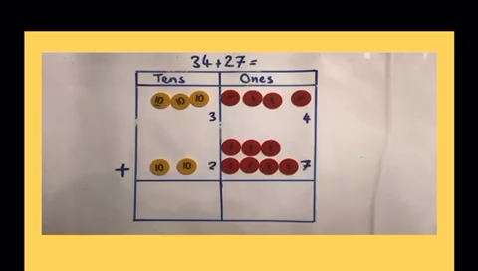

Slide 4
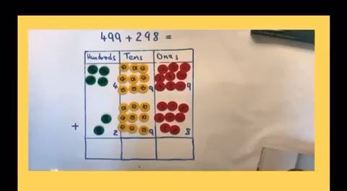

Slide 5
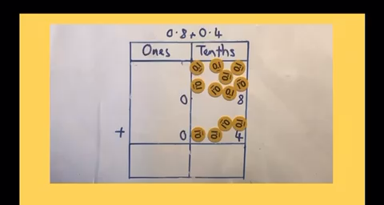

Slide 6
6 7
+ 5 2
5 9
+ 7 2
1 9 2
+ 3 7 6
8. 4 9
+ 7. 2 4
0. 6 2
+ 3. 5 2

Slide 7
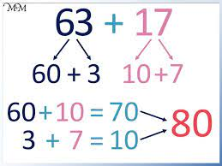
Partitioning

Slide 8
41 + 56
Let’s partition – starting with the units/ones
1 – how many units in 41
2 – how many units in 56
3 – how many units altogether?
4 – how many tens in 41?
5 – how many tens in 56?
6 – how many tens altogether?
7
=
9
41 + 56

Slide 9
54 + 27
1 – How many units in 54?
2 – How many units in 27?
3 – Would we write 11 in the units column?
4 – We remove ten ones and turn it into a ten
5 – We write 1 in the units column as that is what we are left with
6 – How many tens in 54?
54 + 27 =
1
7 – How many tens in 27?
8
11
1
7 – How many tens altogether?

Slide 10
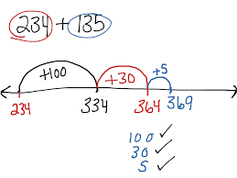
Number Lines

Slide 11
Number lines
Let’s represent the addition problem:
56 + 27

Slide 12
Number lines
Let’s represent the addition problem:
123 + 46

Slide 13
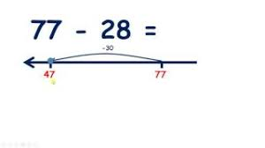
Adjusting

Slide 14
Adjusting
Let’s represent the addition problem:
56 + 27 We can do 56 + 30 then subtract 3

Slide 15
Adjusting
Let’s represent the addition problem:
123 + 46 We can do 123 + 50 then subtract 4

Slide 16
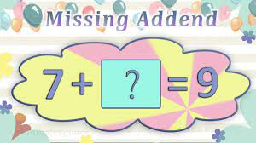
Missing Addends

Slide 17
Alternative number line strategy
31
25 + ____ = 56
+30
+1
25
55
56

Slide 18
Subtraction
We have learned various strategies for subtraction:
Formal methods
Partitioning
Number lines
Adjusting
Finding missing subtrahends

Slide 19
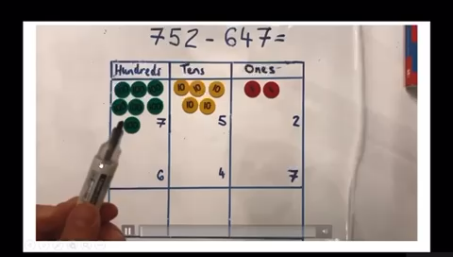

Slide 20
6 7
- 5 2
9 9
- 7 2
5 9 2
- 3 7 6
1 8. 4 9
- 7. 2 4
8. 6 2
- 3. 5 9

Slide 21
37 - 13
= 24
How many tens?
How many ones?
How many ones should we take away?
How many tens should we take away?

Slide 22
256 - 23
= 233

Slide 23
Let’s partition!
7 2
6
1
- 2 8
4
4

Slide 24
Let’s partition!
3 4 6
1
2
3
1
- 1 6 7
1
7
9

Slide 25
Number Lines

Slide 26
Number lines
Let’s represent the subtraction problem:
56 - 23

Slide 27
Adjusting

Slide 28
Adjusting
Let’s represent the subtraction problem:
57 - 43 We can do 57 - 40 then subtract 3 more

Slide 29
Adjusting
Let’s represent the subtraction problem:
183 - 46 We can do 183 - 50 then add back 4

Slide 30
Missing Subtrahend

Slide 31
Example!
25
44 - ___ = 19
- 10
- 4
- 5
25
29
34
44

Slide 32
Multiplication
We have learned various strategies for multiplication:
Place value x 10, 100, 1000
Multiplying multiples of 10
Partitioning
Grid Method
Formal methods

Slide 33
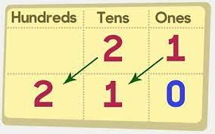
Multiplying powers of 10

Slide 34


Slide 35
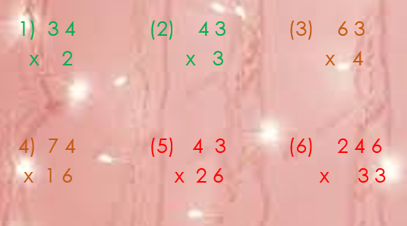

Slide 36
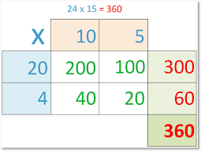
Partitioning/Grid Method

Slide 37




Grid Method
23 X 3
X
20
3
3
60
+
9
=
69

Slide 38

24 X 3
20
4
X
3
+
12
=
72
60

Slide 39
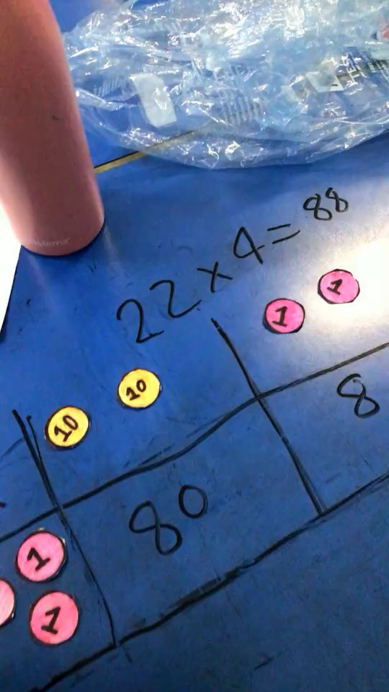

Slide 40
Introducing the grid method strategy and understanding why partitioning is important
X
20
29 x 21
20
9
20
400
180
9
20
1
1
20
9
29 x 21 = 609

Slide 41
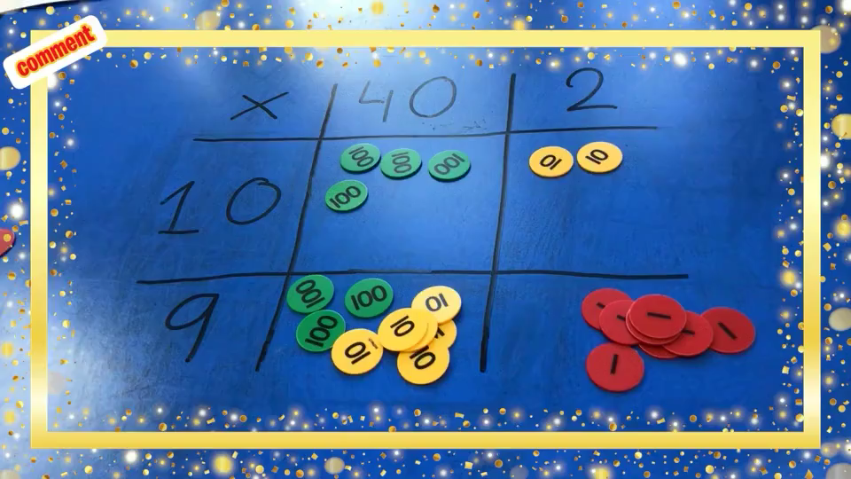

Slide 42
Division
We have learned various strategies for division:
Divide by 10 100 1000
Times tables link
Partitioning
Chunking
Formal methods/bus stop

Slide 43
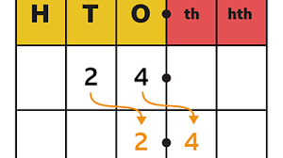
Divide 10 100 1000

Slide 44
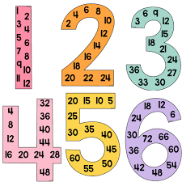
Times table link

Slide 45
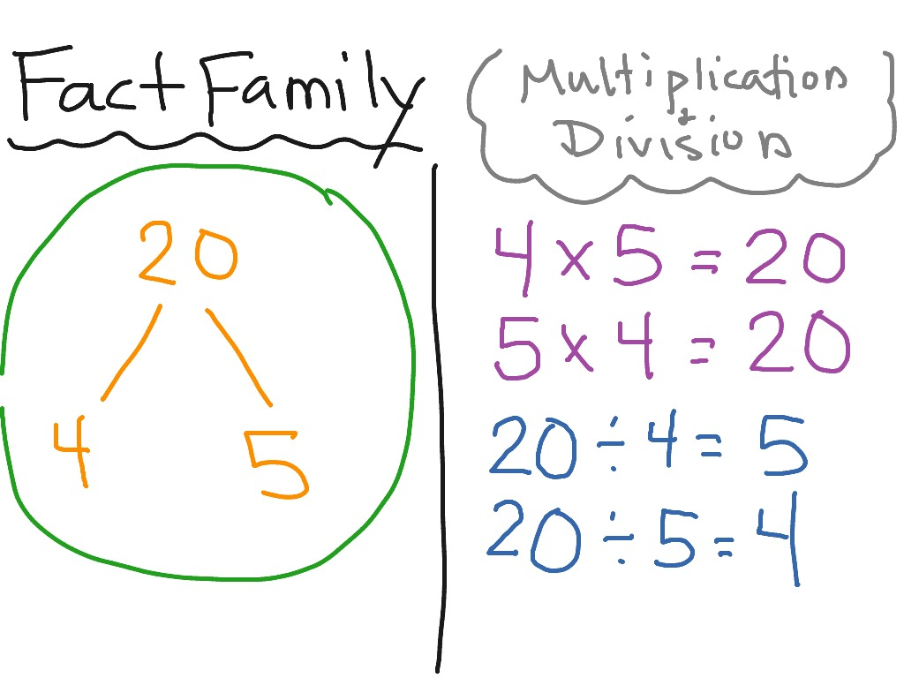
Strategy 1.Fact Families
This is a strategy we can use when
working with division!
Here is an example:

Slide 46
Strategy 2. Using our times table knowledge:
If we looked at these questions:
30 divided by 5
2. 18 divided by 2
What strategy would you use to solve them? Write your answers on your whiteboards!

Slide 47
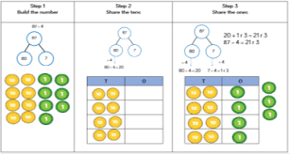
Partitioning

Slide 48
Partitioning for division
Let’s look at 48 ÷ 4
= 12
First we partition 48
40
8
Now we divide our tens and units by 4

Slide 49
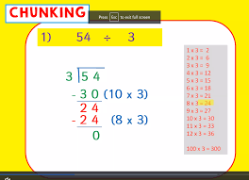
Chunking

Slide 50
Chunking for division
Let’s look at 48 ÷ 4
= 12
First we CHUNK 48
-40
10 x 4
8
What two numbers in the 4 times tables would you use to chunk 48?
A good place to always start is 10 x the number you are dividing by.
2 x 4
-8
0
10 + 2 = 12
Is 8 in the 4 times tables? If so, _ x 4 = 8?

Slide 51
Chunking for division
Let’s look at 96 ÷ 6
= 16
First we CHUNK 96
-60
10 x 6
36
What two numbers in the 6 times tables would you use to chunk 96?
A good place to always start is 10 x the number you are dividing by.
6 x 6
-36
0
10 + 6 = 16
Is 36 in the 6 times tables? If so, how _ x 6 = 36?

Slide 52
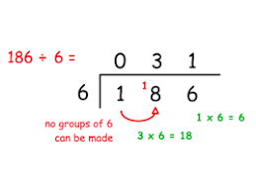
Bus stop/Formal methods

Slide 53
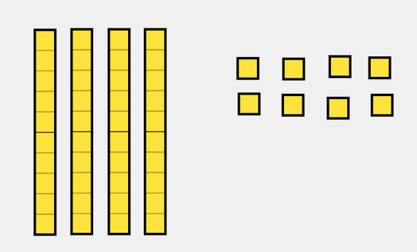



Bus stop/Formal methods
1
2
48 ÷ 4
4
4 8

Slide 54
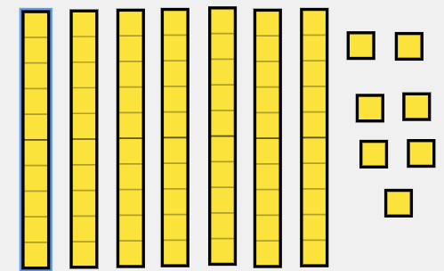
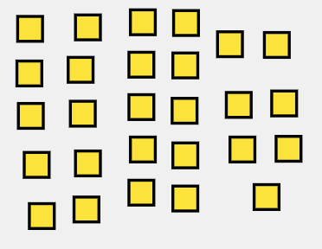
Bus stop/Formal methods
77 ÷ 5
1
5
r 2
5
2
7 7

